Slide 1
R Programming for Statistical Analysis
Day 1- Session 3
‘Programming in R’
Presenter: Hammed Akande

Slide 2
Learning objectives
By the end of this presentation, you will be able to…
Distinguish between individual commands, blocks of code, and functions
Understand the utility of functions
Write a basic function
Understand the utility of iteration
Write a basic loop

Slide 3
Commands, code, functions...oh my!
As with any other subject, you will find that different people use different terms to discuss programming
‘Go write a script to do…’
‘Can you look over my code?’
‘I need some help implementing a function…’
‘I need to set up conditions over my data…’
‘I am looping through hundreds of files…’
‘I need a command that can…’
So what are the general differences between these terms?

Slide 4
Building a general vocabulary around programming
A command usually refers to the execution of a single task
The ‘command line’ generally allows the execution of a single task at a time
These tasks can be simple, or very complex
# This is a ‘command’ to print the words ‘Hello world!’
> print(‘Hello world!’)
[1] “Hello World!”

Slide 5
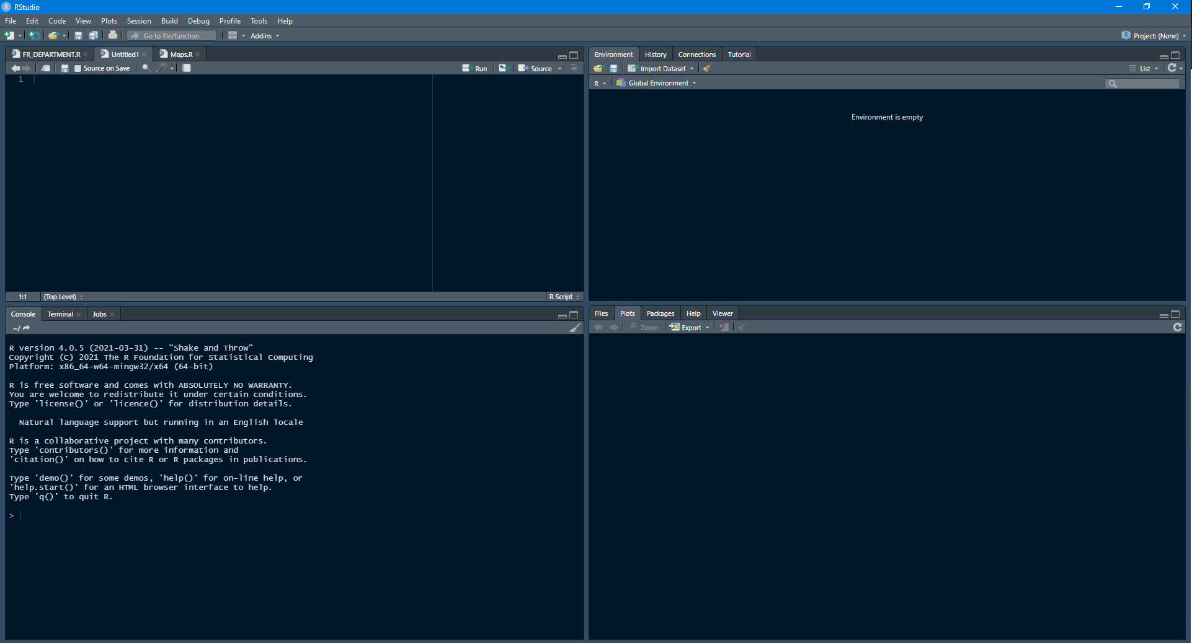
Building a general vocabulary around programming
Remember that in R the ‘command line’ is called Console, located in the bottom-left corner by default
In the Console we can only execute one command at a time

Slide 6
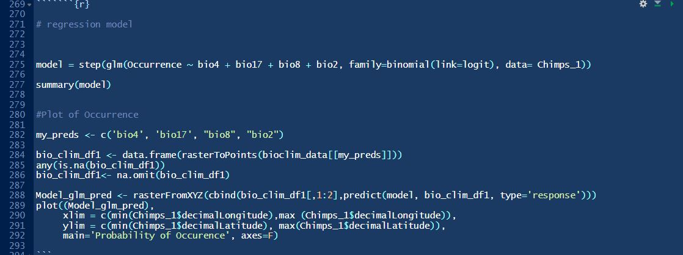
Building a general vocabulary around programming
Code is the execution of many commands in a specific order
Code usually refers to many commands and comments
People may also refer to code as ‘blocks of code’ or ‘chunks of code’ or ‘scripts’

Slide 7
Why is a general vocabulary around programming important?
When receiving a task, you need to recognize what the task requires!
‘Write some code…’
‘Write a function that…’
‘Set conditions’
‘Loop through the files…’

Slide 8
So what is a function, anyways?
A function is a way to combine one or more commands and automatically apply the commands on inputs
Functions can be simple or complex
Most of the tools in R are functions

Slide 9
The key components of a function
Functions will almost always have the following components:
Name: the name of the function
Input(s): one or more expected inputs that will travel through the function (also called arguments)
Commands: one or more commands that will execute on the expected inputs
Output(s): or or more outputs that are returned to the user upon completion of the function

Slide 10
The structure of functions in R
Consider the following example function
Name of function
Inputs
ExampleFunction <- function(input1, input2){
# Comment to ease understanding
TemporaryObject1 <- doSomething(input1, input2)
# More explanation
ProcesseObject <- doSomethingElse(TemporaryObject1)
# When you are done with the function,
# return the desired outputs
return(ProcesseObject)
Commands
Output

Slide 11
Building your first function
Imagine you are assigned the following task:
“Build a function that prints a happy birthday message to someone. The function should take the person’s name and birthday.”

Slide 12
Building your first function
Let’s break down the task into what the function should look like
“Build a function that prints a happy birthday message to someone. The function should take the person’s name and birthday.”
Name: HappyBirthday
Input(s): name, birthday
Commands: build a sentence
Output(s): happy birthday message

Slide 13
Name of function
Inputs
HappyBirthday <- function(Name, Birthday) {
# Build an object that stores the happy birthday msg
Sentence <- paste0(
"Hi ",
Name,
"! Because today is ",
Birthday,
" it is your ",
"very special day. Happy birthday!"
)
# Return the birthday message
print(Sentence)
}
HappyBirthday("Jeff Sauer", "Aug 1., 1992")
[1] "Hi Jeff Sauer! Because today is Aug 1., 1992 it is your very special day. Happy birthday!"
Command
Output
Call the function on new data

Slide 14
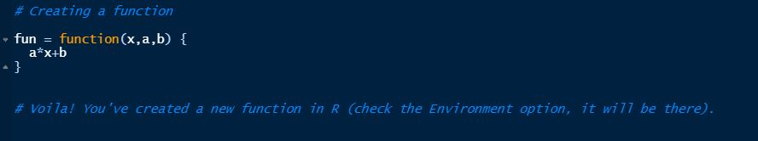
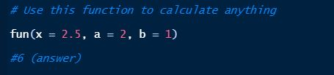
Let's do this for real numbers - using simulation
Suppose we want to create a simple linear function, such as f(x,a,b) = ax + b,

Slide 15

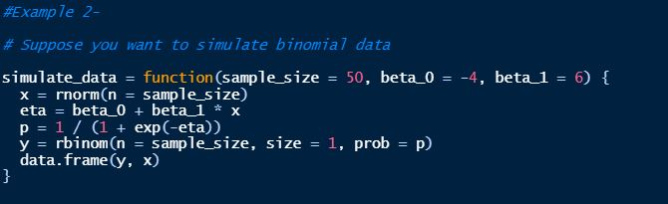
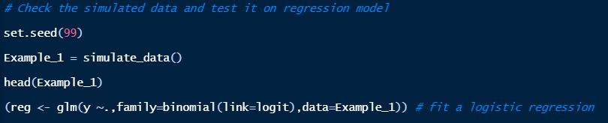
Example 2- using simulation
Suppose you want to simulate binomial data (of course you can simulate almost any data)

Slide 16
When should you write a function?
If you ever find yourself repeating the same set of commands more than three times, it may be helpful to write a function!
In addition, functions have several other benefits. Consider the following example...

Slide 17
When should you write a function?
Imagine that you have a dataframe of several variables (variables a, b, c, d, and e). Suppose you need to multiply each variable by a different adjustment factor. For example:
However, do you see the mistake?
df$a <- df$a*100
df$b <- df$a*72
df$c <- df$a*30
df$d <- df$a*12
df$e <- df$a*43

Slide 18
When should you write a function?
Although we change the adjustment factor for each line of code, we did not change the index of the variable we were meant to be adjusting!
This illustrates an important benefit of functions: functions can also help avoid mistakes related to typos when repeating large amounts of code.
df$a <- df$a*100
df$b <- df$a*72
df$c <- df$a*30
df$d <- df$a*12
df$e <- df$a*43

Slide 19
When should you write a function?
To summarize, functions have several benefits:
Functions allow for the combination of several lines of code that can be applied to different inputs
Functions help avoid incidental mistakes when repeating large amounts of code
Functions help code to stay succinct and easily readable (e.g., it is very easy to determine the purpose of a function with a name like HappyBirthday)

Slide 20
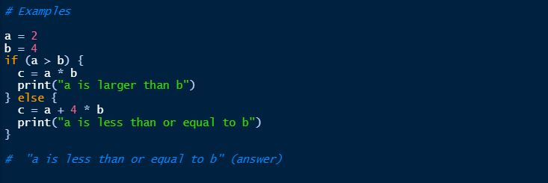
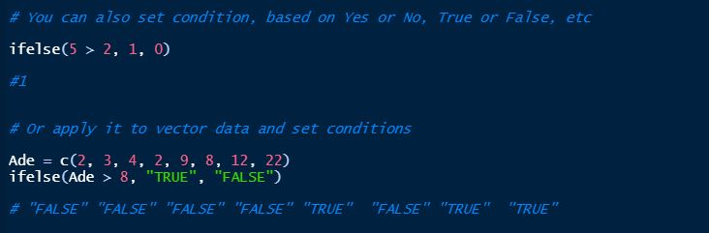
Conditional Statement
If/else
if (...) {
#enter some R code
} else {
#add more R code
}

Slide 21
Other common programming operations - iteration
While a function executes several commands on a single set of inputs, how might we apply a function to several sets of inputs?
Recall our HappyBirthday() function. What if we wanted to apply the HappyBirthday() function to a list of 10,000 people?
The general vocabulary of repeating tasks is called iteration

Slide 22
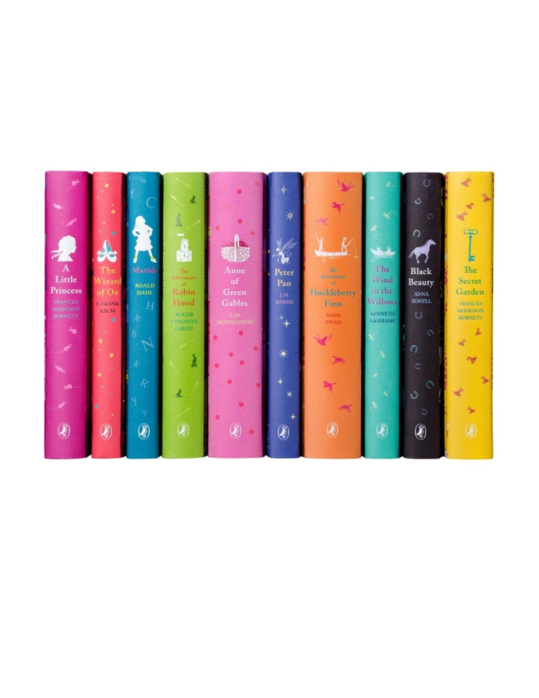
A specific type of iteration: loops
Looping is a powerful operation that allows you to repeat a set of commands on a set of iterables
For example, imagine you have a row of 10 different books. I ask you to say the name of each book in the pile. You might naturally start at first book, saying each name until there are no books left.
Book 1
Book 2
Book 10

Slide 23

The structure of loops in R
List of iterables we want to loop through
Iterator
(can be any word or character)
for(i in book_titles){
print(i)
}
The action we want the loop to execute

Slide 24
Your first for loop in action
book_titles <- c('Book 1', 'Book 2', 'Book 3', 'Book 4', 'Book 5')
for(i in book_titles){
print(i)
}
[1] "Book 1"
[1] "Book 2"
[1] "Book 3"
[1] "Book 4"
[1] "Book 5"

Slide 25
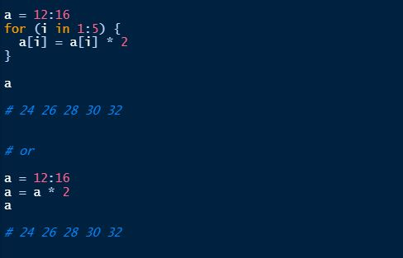
Loop example using numbers

Slide 26
When should you write a loop?
Similar to functions, you should write a loop whenever you need to apply a function to more than a few objects
For example, imagine that you are loading data into RStudio. If your data is spread across three .csv files, it is not a big issue to simply call read.csv a few times:
But what if you have 10, 20, 30, 40, or even more .csv? Consider a loop!
read.csv(...)
read.csv(...)
read.csv(...)

Slide 27
Additional resources on advanced programming in R
R for Data Science: https://r4ds.had.co.nz/functions.html
Advanced R: https://adv-r.hadley.nz/functions.html
Data Carpentry: https://swcarpentry.github.io/r-novice-inflammation/
Software Development in R: https://bookdown.org/rdpeng/RProgDA/

